Slide 1
MindScope – Depression Detection Engine
Depression Detection from Social Media Posts

Slide 2
Challenges
Ambiguous Self-Expression
Sad words ≠ depression; people often hide or exaggerate
Solution: Use multi-feature signals (emotion, writing style, context)
Overfitting to Trigger Words
Models may rely on simple words like “sad” or “kill”
Solution: Add deeper linguistic and contextual features
Weak or Unreliable Labels
True diagnosis requires professionals; online labels may be noisy
Solution: Mix self-report + expert review; validate small samples
Lack of Context
Single posts do not reflect long-term depression
Solution: Use multi-post or time-based analysis when possible
Temporal Drift
Language and mental-health trends change over time
Solution: Re-train and monitor models regularly

Slide 3

Your title here
Step-by-Step Flow:
Installation and Setup.
Authenticate Reddit API using credentials.
Using pre-trained Model(distilroberta) to label the raw data.
Load existing data from CSV — if not found, scrape Reddit (depression + control subreddits).
Explore dataset using DataVisualizer
Initialize the depression detection model.
Train and evaluate model (Logistic Regression, Random Forest, SVM) with an 80–20 train–test split.
Visualize results (accuracy, F1, AUC, confusion matrices).
Analyze top important features (e.g., “hopeless”, “I”, “tired”).
Test model on sample texts and print depression probabilities + linguistic feature values.
Print best-performing model summary.
Return: model, results, and data.

Slide 4
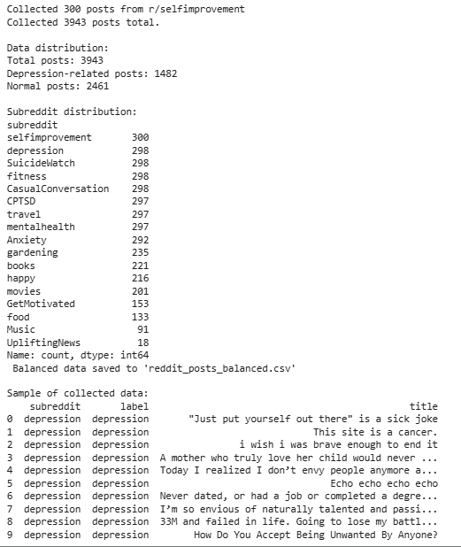
Reddit Data Collection
1. Installation & Setup
Install required packages: praw, textstat, spacy, matplotlib, seaborn, wordcloud
Download spaCy English language model
Import necessary libraries
2. Reddit API Configuration
Initialize PRAW Reddit instance with API credentials
Set up client ID, client secret, and user agent
3. Subreddit Selection
Define depression-related subreddits: depression, SuicideWatch, mentalhealth, Anxiety, CPTSD
Define neutral/normal subreddits for balanced dataset
Combine both lists into target subreddits
4. Data Collection
Iterate through each target subreddit
Apply classification labels: "depression" for mental health subreddits, "normal" for others
Collect posts using subreddit.hot(limit=300) method
Filter out empty posts and stickied posts
Extract post metadata: title, text, timestamp, score, comments, ID, URL
Implement error handling and rate limiting
5. Data Analysis
Convert collected posts to pandas DataFrame
Analyze data distribution by label and subreddit
Display counts of depression vs normal posts
Show subreddit-wise distribution
6. Data Export
Save collected data to CSV file: "reddit_posts_balanced.csv"
Display sample of the collected data

Slide 5
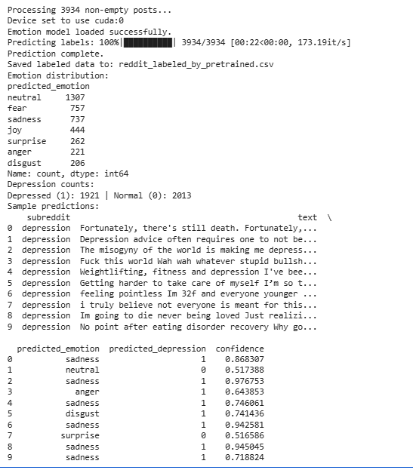
Labelling by Pre-trained Model:
Uses j-hartmann/emotion-english-distilroberta-base for emotion detection, with fallback to distilbert-base-uncased-finetuned-sst-2-english (sentiment) if needed.
Input file: Must include at least text or title columns.
Output file:reddit_labeled_by_pretrained.csv
with extra columns:
predicted_emotion, confidence, predicted_depression, label_source

Slide 6
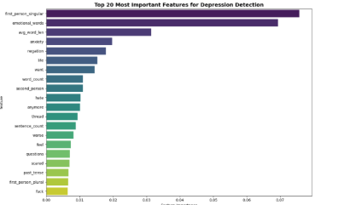
Text Preprocessing
This cell defines the text preprocessing class that handles cleaning and extracts linguistic features important for depression detection.
The AdvancedTextPreprocessor class is responsible for turning raw Reddit text into a cleaned, lemmatized version ready for TF-IDF or other text vectorization , a dictionary of linguistic/psychological features (ratios of pronoun use, emotional words, etc.)
1) Initialization —init()
2)Text cleaning —clean_text(text)
3) Linguistic feature extraction —extract_linguistic_features(text)
4)Tokenization and Lemmatization —tokenize_and_lemmatize(text)
5)Full pipeline —preprocess_text(text, extract_features=True)
Returns:
processed_text → cleaned, lemmatized text (for TF-IDF input)
linguistic_features → dictionary of numeric features

Slide 7
Feature Engineering
This cell combines TF-IDF features with linguistic features to create comprehensive text representations for machine learning.
Why Combine Linguistic + TF-IDF?
TF-IDF :
Captures what is said (the literal words, phrases, and their statistical importance), highlights distinctive words and reduces common word occurence.
Linguistic features :
Capture how it’s said (psychological style, structure, and emotional cues).
When combined, we get both:
Semantic information (topics, keywords)
Psychological signal (tone, self-focus, emotion, cognitive load).
This combination tends to boost model performance in depression detection and other affective computing tasks.

Slide 8
Depression Detection Model
This cell defines the main model class that implements multiple machine learning algorithms and handles training/evaluation.
The models used are: Logistic Regression, SVM and Random Forest.
DepressionDetectionModel is a wrapper class that:
Integrates our preprocessing (AdvancedTextPreprocessor)
Integrates our feature engineering (FeatureEngineer)
Defines and trains multiple ML classifiers
Evaluates, visualizes, and interprets their performance
Can make predictions on new text
It’s the top-level “manager” that ties your entire pipeline together.

Slide 9
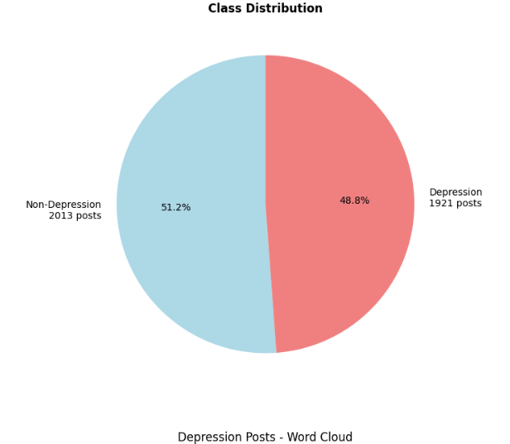
Data Visualization:
This class (DataVisualizer) performs data exploration and visualization for a dataset containing social media posts. It:
Displays dataset statistics such as total posts and class distribution (depression vs non-depression).
Creates visual insights including:
  Pie chart for class balance.
  Histogram showing post length distribution.
  Word clouds highlighting common words in each class.
  Subreddit-level analysis (if available) showing where depression-related posts are most common.
Overall, it helps understand the dataset’s composition and key text patterns visually.

Slide 10
main() Execution
This function runs the complete depression detection pipeline on an existing dataset (CSV file). It:
Loads and prepares data using DataLoader.
Explores the dataset visually with DataVisualizer.
Trains and evaluates depression detection models.
Visualizes results and analyzes important linguistic features.
Tests the model on sample texts to show prediction results.
Displays final performance metrics (accuracy, F1-score, precision, recall, AUC).
Overall, it automates the end-to-end workflow — from data loading to model interpretation and performance reporting.

Slide 11
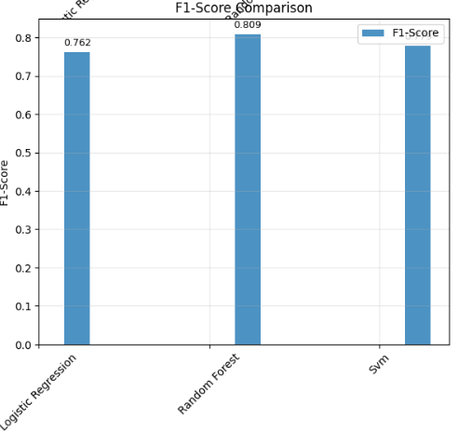
Results
Random Forest Results:
Accuracy: 0.8158
AUC-ROC: 0.8897
Precision: 0.8187
Recall: 0.7995
F1-Score: 0.8090
CV Accuracy: 0.8008 (±0.0210)
Data Split:
Training samples: 3147
Testing samples: 787
Features: 3013
Logistic Regression Results:
Accuracy: 0.7726
AUC-ROC: 0.8598
Precision: 0.7793
Recall: 0.7448
F1-Score: 0.7617
CV Accuracy: 0.7798 (±0.0460)
Svm Results:
Accuracy: 0.7916
AUC-ROC: 0.8632
Precision: 0.8073
Recall: 0.7526
F1-Score: 0.
CV Accuracy: 0.7823 (±0.0292)

Slide 12
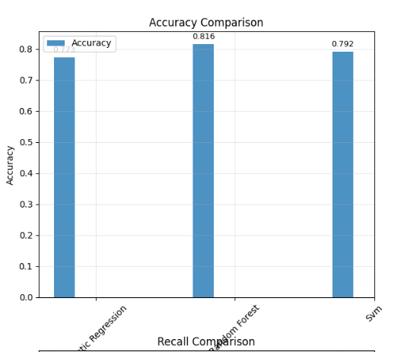
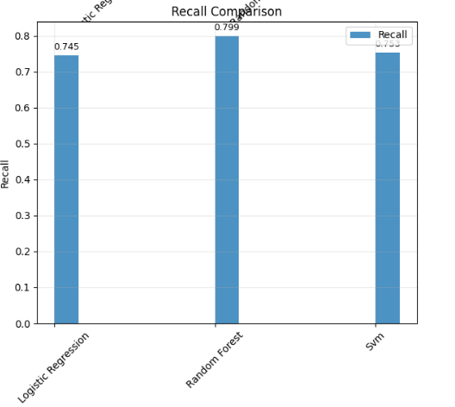
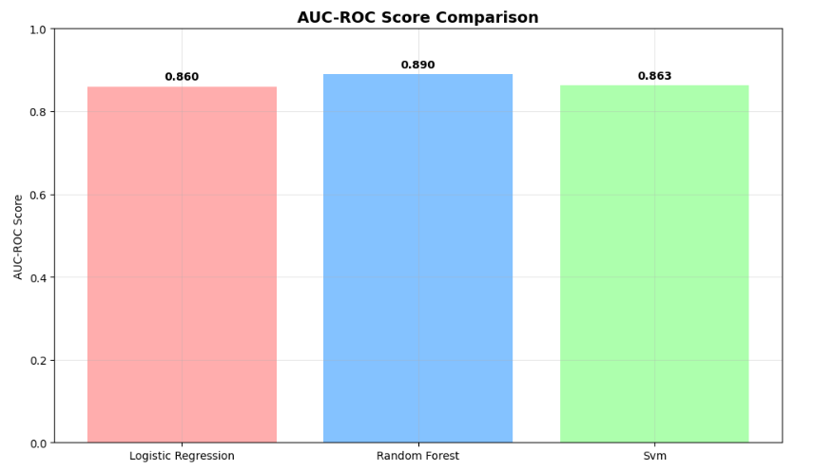
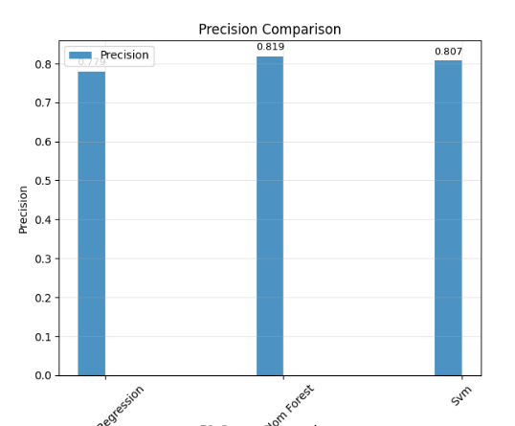

Slide 13
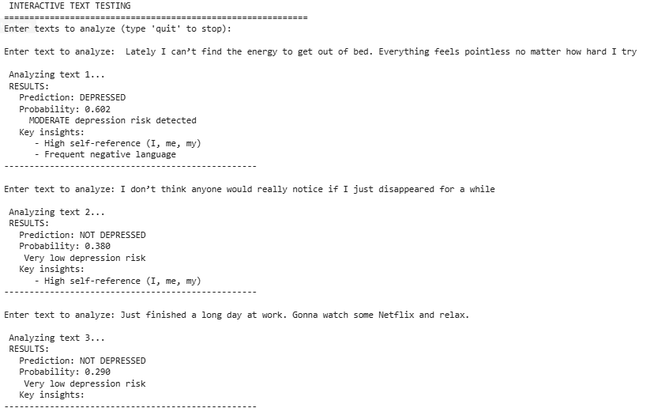
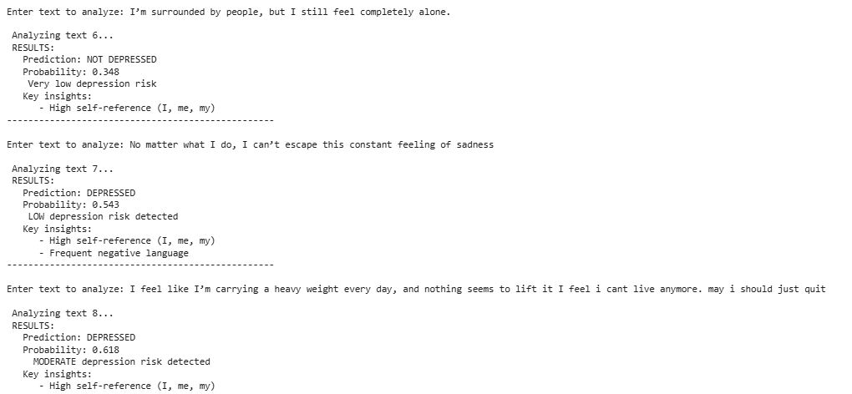
Custom Testing

